Slide 1
Stroke classification project
Neural networks

Slide 2
Agenda
Abstract 4
Introduction 5
Problem 7
Proposed Work 8
CNN model 12
Transfer Learning model 18
Conclusion 49

Slide 3
Eng/ Ahmed Youssry
Team Member
Ahmed Adel Mohieddin
Khaled Ahmed Salah
Menna Hesham Ahmed
Mayar Mahmoud Abdel-Hamied

Slide 4
Abstract
This project aims to develop a stroke classification system using Convolutional Neural Networks (CNNs) and transfer learning. Stroke is a leading cause of death and disability worldwide, and early detection and intervention can improve patient outcomes. The proposed system will take in medical imaging data such as CT or MRI scans, extract relevant features using image processing techniques, and feed them into a CNN for classification. The CNN will be trained on a large dataset of labeled stroke and non-stroke cases using transfer learning algorithms. The performance of the system will be evaluated using various metrics such as accuracy, precision, recall, and F1 score.

Slide 5
Introduction
Stroke is a serious medical condition that requires accurate and timely diagnosis to improve patient outcomes. In recent years, there has been growing interest in developing machine learning algorithms to assist in the classification of stroke cases. Convolutional Neural Networks (CNNs) are a type of machine learning algorithm that can learn complex patterns and relationships in image data, making them well-suited for stroke classification. Transfer learning is a technique where a pre-trained neural network is fine-tuned for a specific task, reducing the need for large amounts of labeled data and improving the efficiency of the training process.

Slide 6
problem
Accurate and timely diagnosis of stroke is critical for improving patient outcomes, but it can be challenging for clinicians. The goal of this project is to develop a reliable and accurate tool that can assist clinicians in diagnosing and treating strokes. The performance of the system will be evaluated using various metrics such as accuracy, precision, recall, and F1 score, and compared to existing methods for stroke classification. By leveraging the power of machine learning and neural networks, we hope to contribute to the growing body of research on stroke classification and pave the way for more effective and efficient stroke diagnosis and treatment.

Slide 7
Proposed Work….

Slide 8
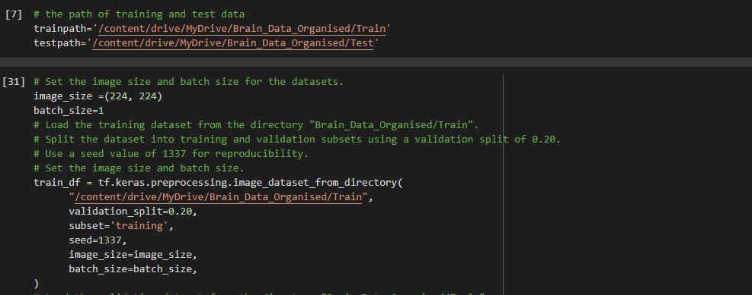
1-Data Collection and Preprocessing: The first step in the proposed work is to collect a large dataset of labeled stroke and non-stroke cases. The dataset will consist of medical imaging data such as CT or MRI scans. The dataset will be carefully curated and preprocessed to ensure high quality and consistency. Preprocessing techniques such as image segmentation or feature extraction will be applied to extract relevant features from the images.

Slide 9
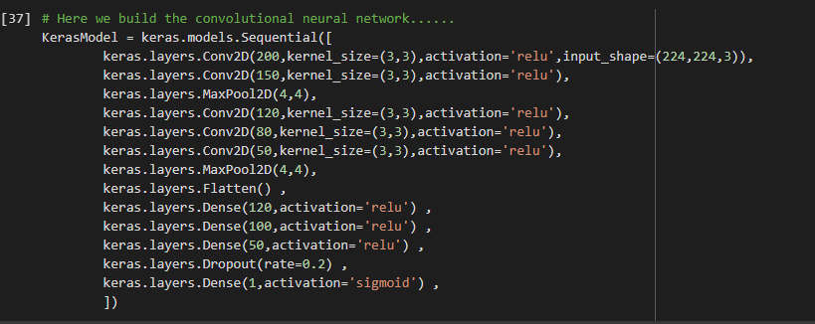
2-CNN Architecture Design: The second step is to design a CNN architecture that can effectively classify stroke and non-stroke cases based on the extracted features. Various architectures such as VGG, Resent, or Inception can be used as a starting point and fine-tuned for the specific task of stroke classification. The architecture will be optimized to achieve high accuracy, precision, recall, and F1 score.

Slide 10
3-Transfer Learning: The third step is to leverage transfer learning to improve the performance of the CNN. Transfer learning involves using a pre-trained neural network and fine-tuning it for the specific task of stroke classification. By using a pre-trained network, we can reduce the need for a large amount of labeled data and improve the efficiency of the training process. We used six pre-trained models :
1-Dense121
2-ResNet50
3-Xception
4-VGG16
5-EfficientNetB1
6-MobileNet

Slide 11
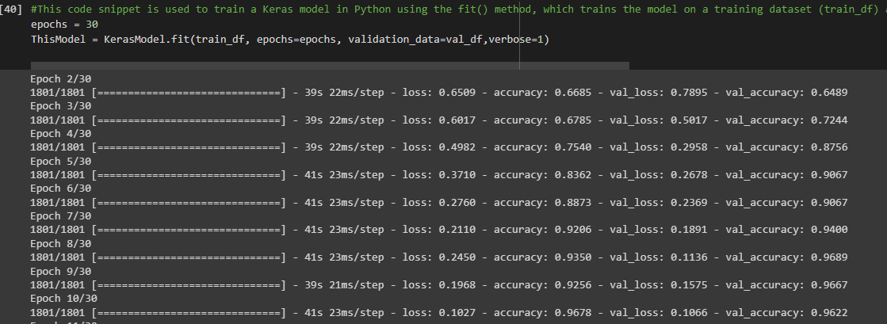
4-Training and Evaluation: The fourth step is to train the CNN using the preprocessed dataset and evaluate its performance using various metrics such as accuracy, precision, recall, and F1 score. The performance of the CNN will be compared to existing methods for stroke classification.

Slide 12
CNN model
In the following slides we will show the results

Slide 13
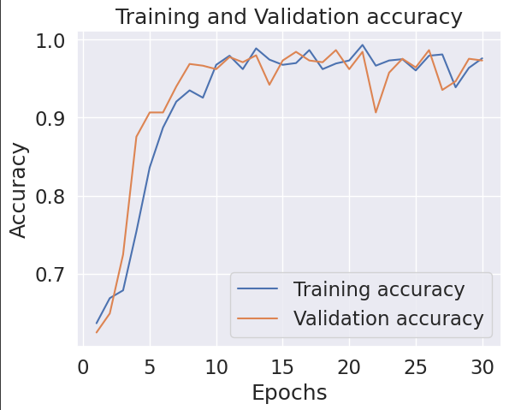
Training and validation accuracy

Slide 14
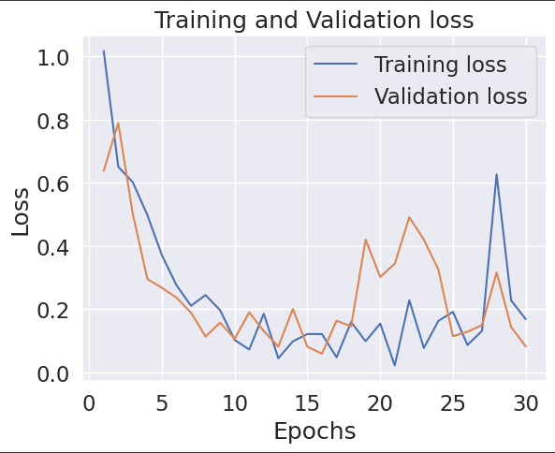
Training and validation loss

Slide 15
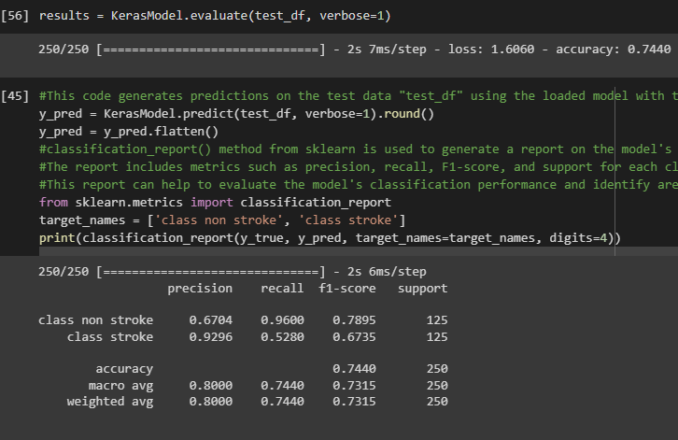
Test accuracy and classification report

Slide 16
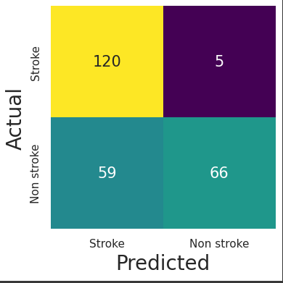
Confusion matrix

Slide 17
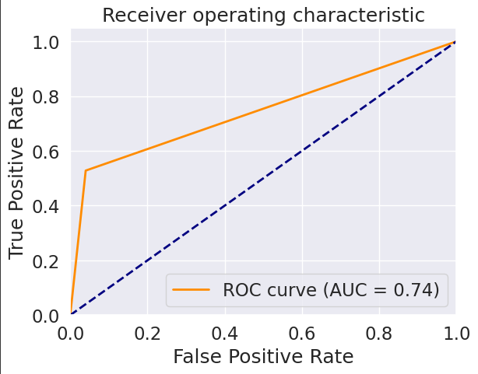
AUC

Slide 18
The results of Dense121

Slide 19
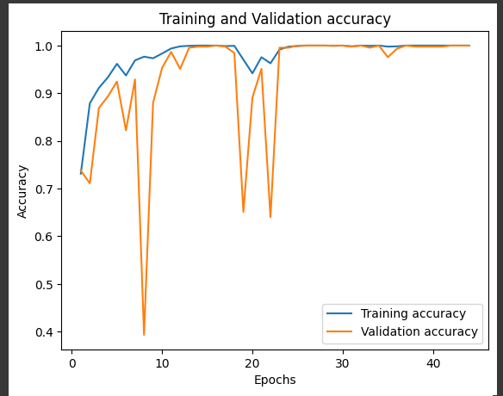
Training and validation accuracy

Slide 20
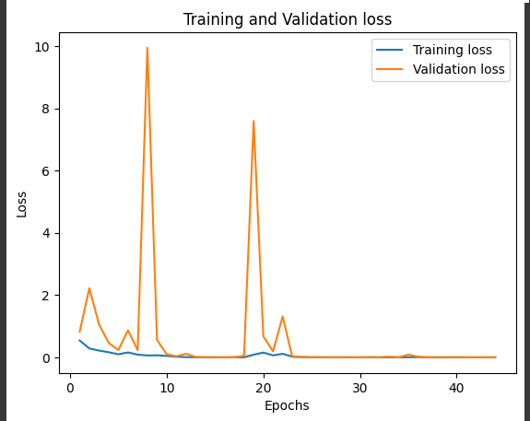
Training and validation loss

Slide 21
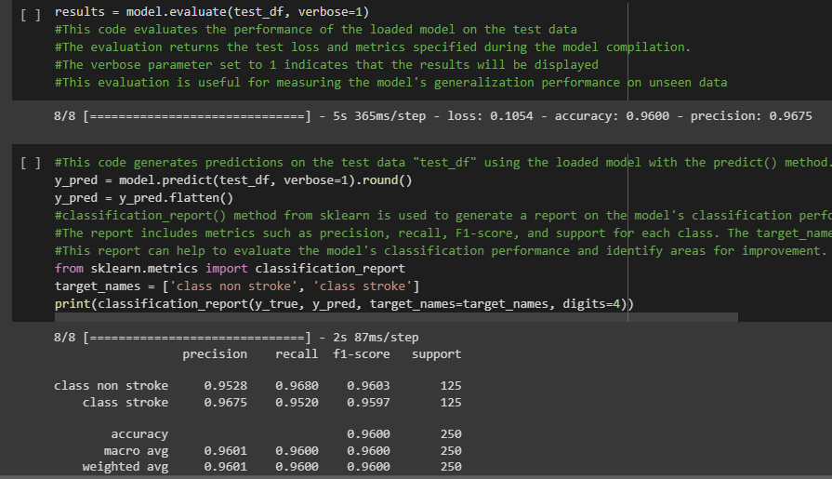
Test accuracy and classification report

Slide 22
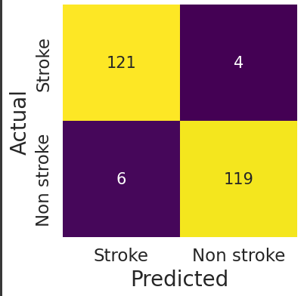
Confusion matrix

Slide 23
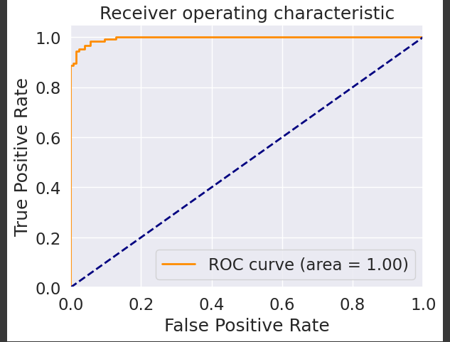
AUC

Slide 24
The results of ResNet50

Slide 25
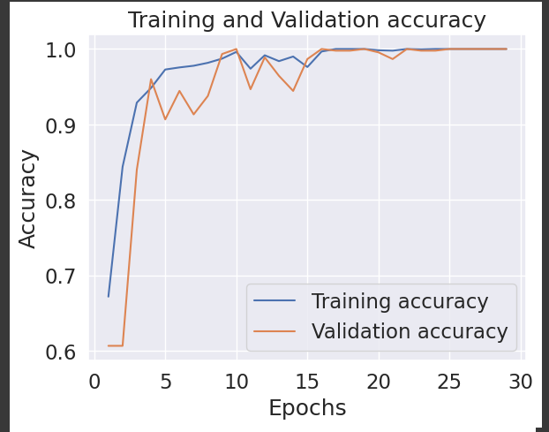
Training and validation accuracy

Slide 26
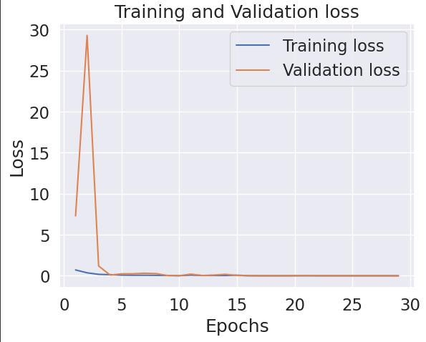
Training and validation loss

Slide 27
Confusion matrix

Slide 28
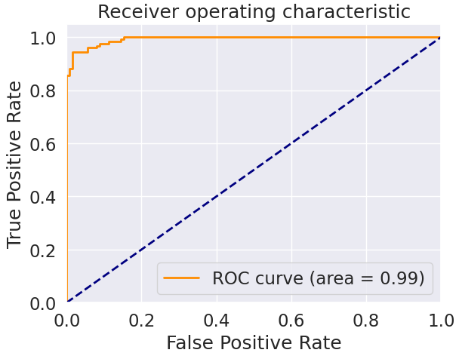
AUC

Slide 29
The results of MobileNet

Slide 30
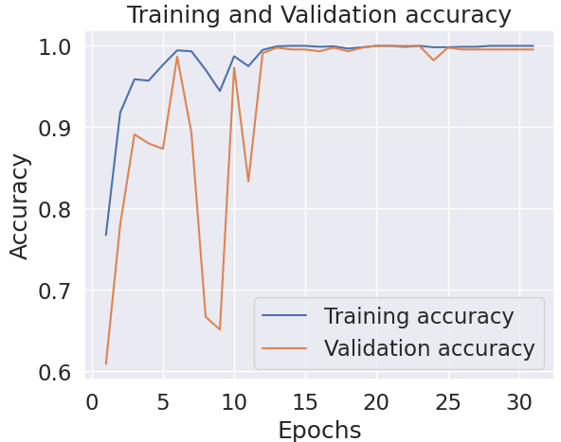
Training and validation accuracy

Slide 31
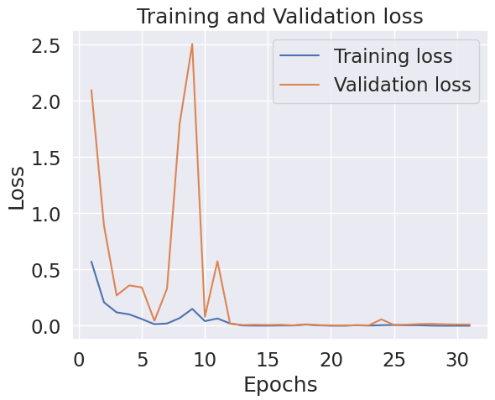
Training and validation loss

Slide 32
Confusion matrix

Slide 33
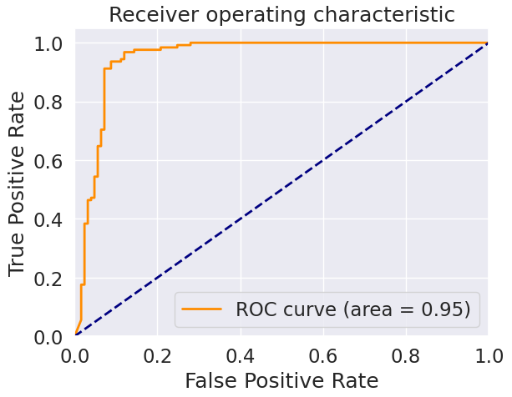
AUC

Slide 34
The results of Xception

Slide 35
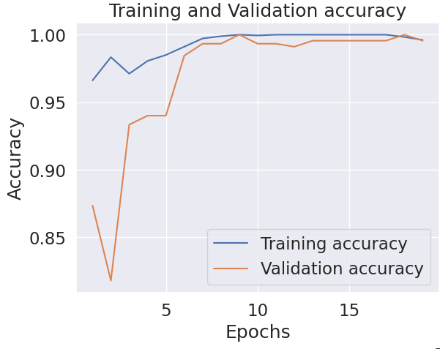
Training and validation accuracy

Slide 36
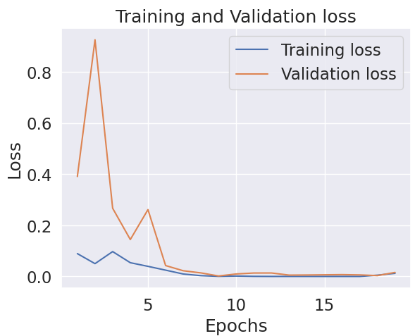
Training and validation loss

Slide 37
Confusion matrix

Slide 38
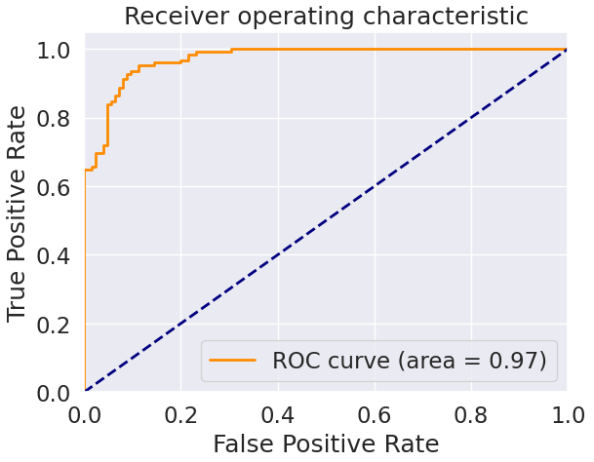
AUC

Slide 39
The results of VGG16

Slide 40
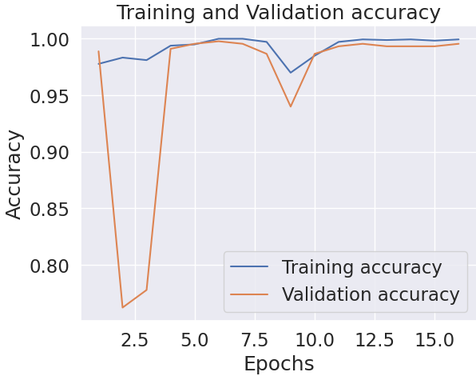
Training and validation accuracy

Slide 41
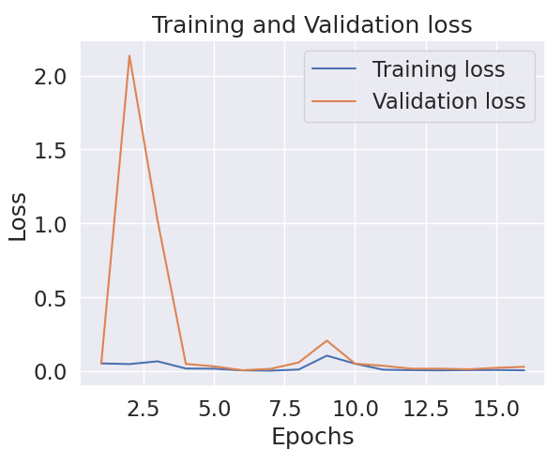
Training and validation loss

Slide 42
Confusion matrix

Slide 43
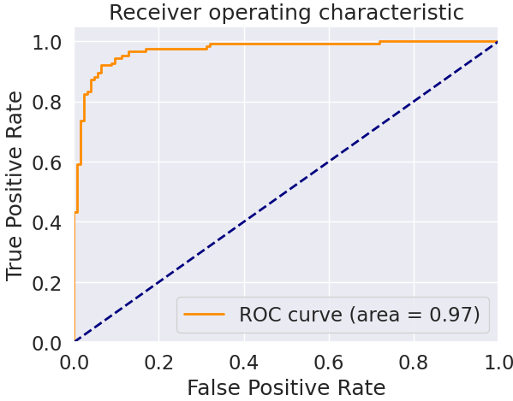
AUC

Slide 44
The results of EfficientNetB1

Slide 45
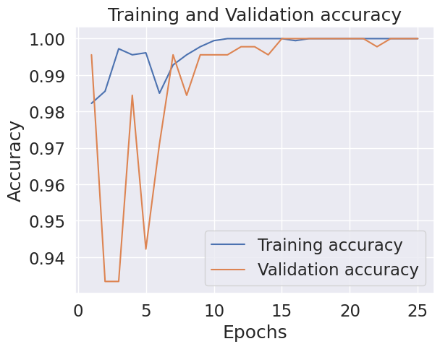
Training and validation accuracy

Slide 46
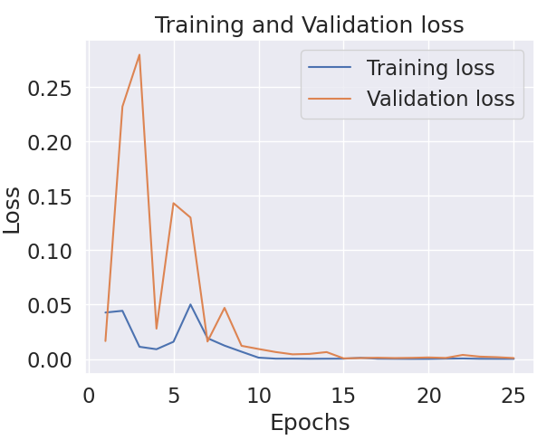
Training and validation loss

Slide 47
Confusion matrix

Slide 48

AUC

Slide 49
Conclusion

Slide 50
In conclusion, stroke classification is a critical area of research that can significantly impact patient outcomes and improve the quality of healthcare. The use of neural networks, specifically Convolutional Neural Networks (CNNs), and Transfer Learning has shown promising results in accurately classifying stroke types using medical imaging data. The implementation of CNN and Transfer Learning algorithms has demonstrated improved accuracy and efficiency in stroke classification compared to traditional models. These advancements in technology have the potential to revolutionize stroke diagnosis and treatment, leading to improved patient outcomes and reduced healthcare costs. As further research and development in neural networks and medical imaging continue, we can expect continued advancements in stroke classification and diagnosis. It is important to continue exploring and developing these technologies to improve the accuracy and speed of stroke diagnosis and treatment, ultimately improving the lives of stroke patients around the world.

Slide 51
Thank you

